Slide 1
COFFEE GRINDER DFM
Reverse Engineering
Michael DeCapua
Alex Klausenstock
Subhraneel Sarkar
Monique Reid
Notes:
Mike
Change title slide picture to isometric view of solidworks assembly?

Slide 2
Why coffee?
70%
62%
20%
Drink coffee every week
Drink coffee every day
Grind coffee at home
U.S. 2020
Notes:
Mike

Slide 3
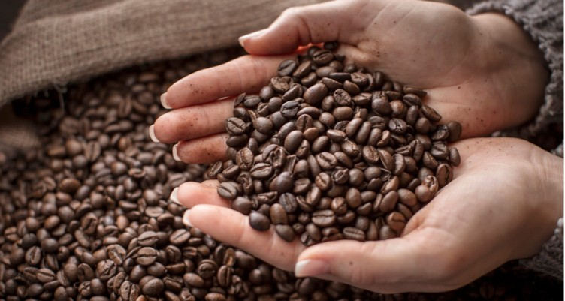
What makes a good cup of coffee?
Fresh beans
Quality water
Adequate filtering
Grinder quality and method
Notes:
Mike

Slide 4
Our Project Goals
Increase assembly efficiencies and reduce secondary operations
Propose improvements in materials and manufacturing processes
Compare and discuss the economic impact of proposed changes
Notes:
Alex

Slide 5
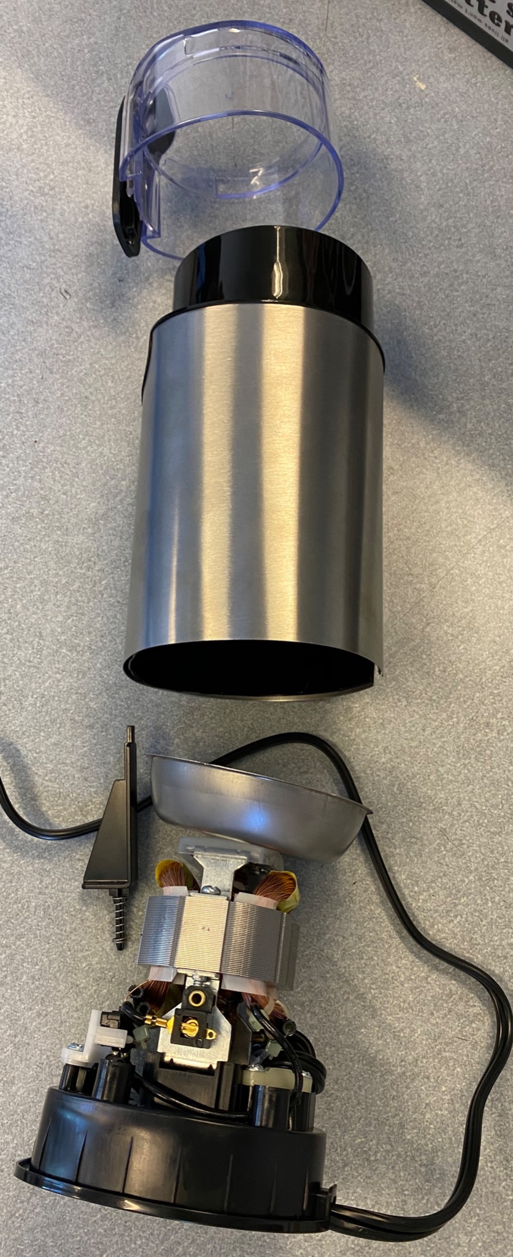
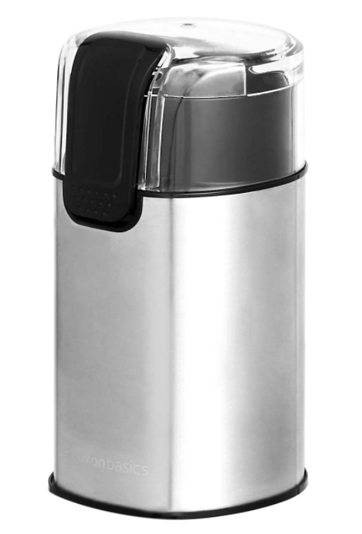
Where did we start?
Started with a simple Amazon Coffee Grinder
Disassembly for Initial investigation
Notes:
Alex

Slide 6
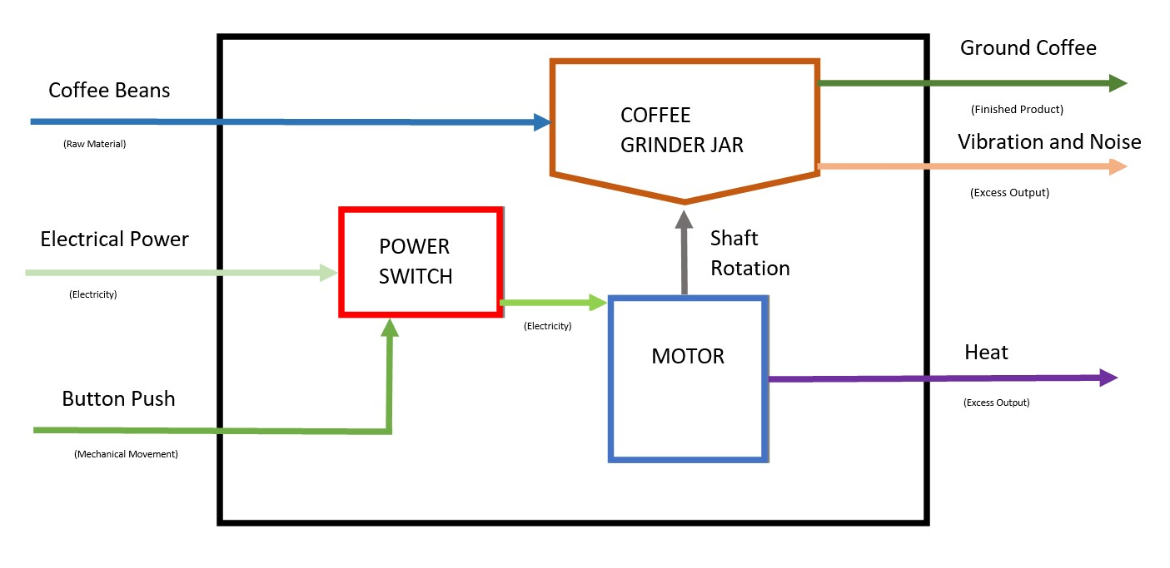
Glass Box Diagram
Notes:
Mike

Slide 7
Project Timeline
Concept
CAD Modeling
Analysis
Purchase assembly and initially inspect
SolidWorks part/assembly and drawing creation
Material, Manufacturing, and Economic Analysis
Research
Redesign
Final Redesign
Research the standard parts and disassemble
Sketch redesigns and brainstorm new concepts
Validate redesign and documentation
Notes:
Mike

Slide 8
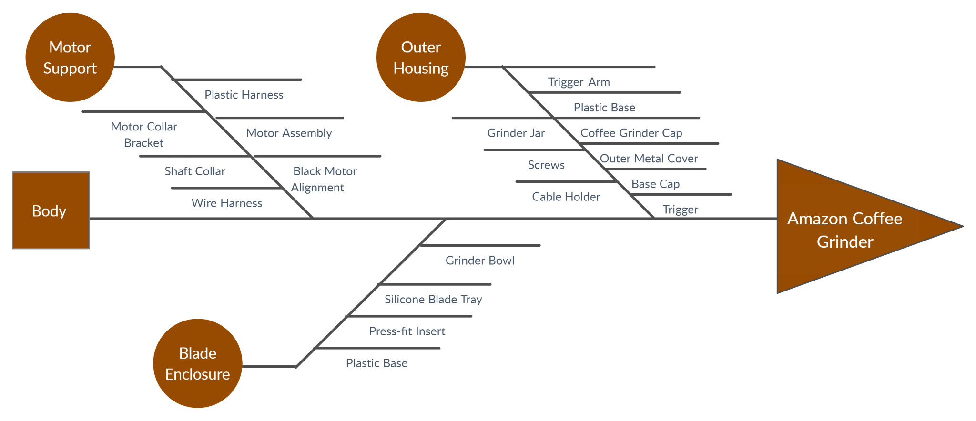
Fishbone Diagram
Notes:
Ron

Slide 9
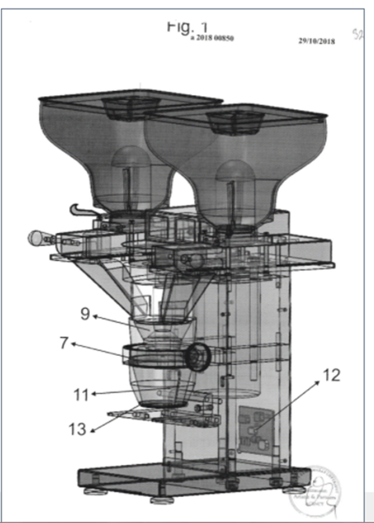
Patent Search
Has 2 coffee containers, each having a blade and grinder bowl
Each container is connected to one channel, and provided with a blocking blade which closes or opens the channel, allowing supply of volumetric charging device
Blade rotation speed is controlled by the PCB
Efficient Grinding
Notes:
Ron

Slide 10
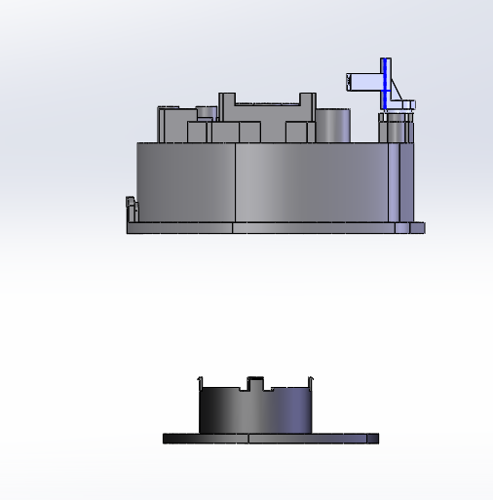
Analysis of Initial Design
Snap fits eliminate the use of fasteners in a majority of assembly
Fasteners are however used in motor assembly to maintain motor stability.
Design for Self Insertion and Self Alignment via Asymmetry
Special asymmetric profile exists in order to lower the possibility of assembling the part in wrong way
Effort was made to simplify the design by:
Reducing part count
Reducing error proofing
Reduce the need for any secondary operations
Notes:
Ron

Slide 11
DFA Analysis and Comparison
Category | Original DFA Metric | Revised DFA Metric
DFA Complexity | 27.350 | 21.909
Theoretical Efficiency | 54.5% | 73.3%
Practical Efficiency | 50.0% | 66.7%
Error Proofing | 0.25 | 0.27
Handling | 0.25 | 0.27
Insertion | 0.50 | 0.55
Secondary Operations | 1.58 | 1.64
Notes:
Mike

Slide 12
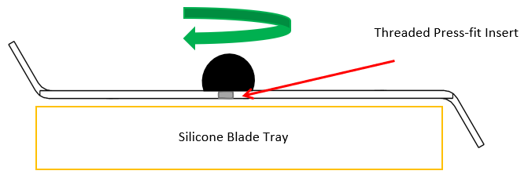
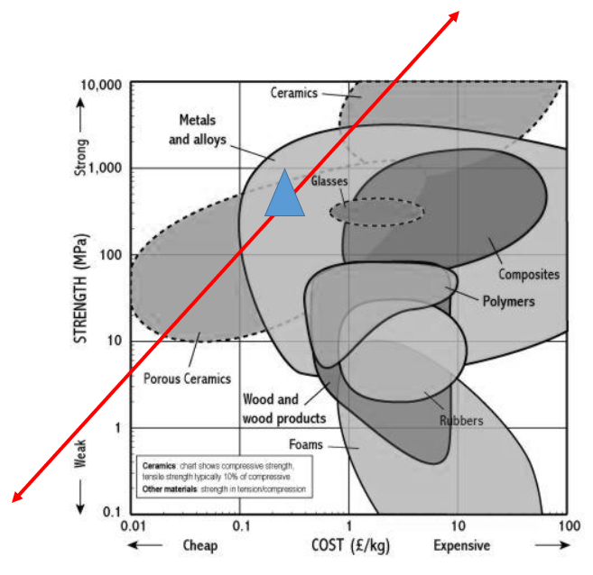
Material Analysis:
Blade Arm
Function:
Rotates about the center of the assembly and grinds coffee beans to the user’s needs
Current Material:
Steel Alloy
Objective:
Potentially remove the press-fit insert part or change material to decrease cost without compromising strength
Conclusion:
Porous ceramics and ceramics meet the strength vs. cost objective but crack easily
Notes:
Monique

Slide 13
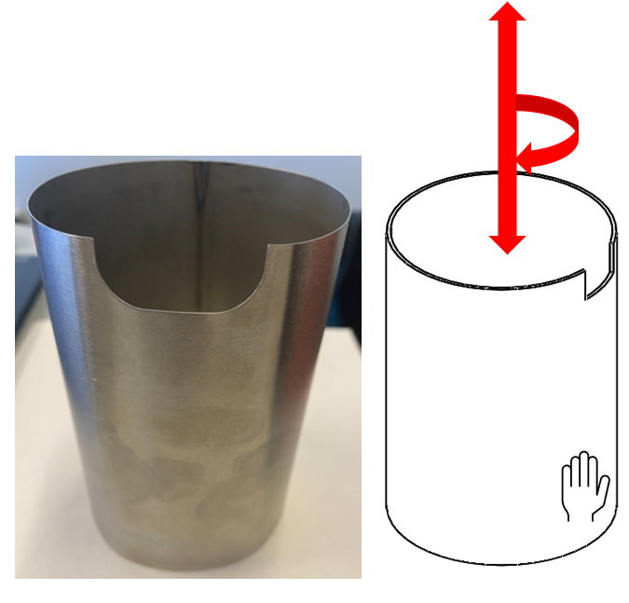
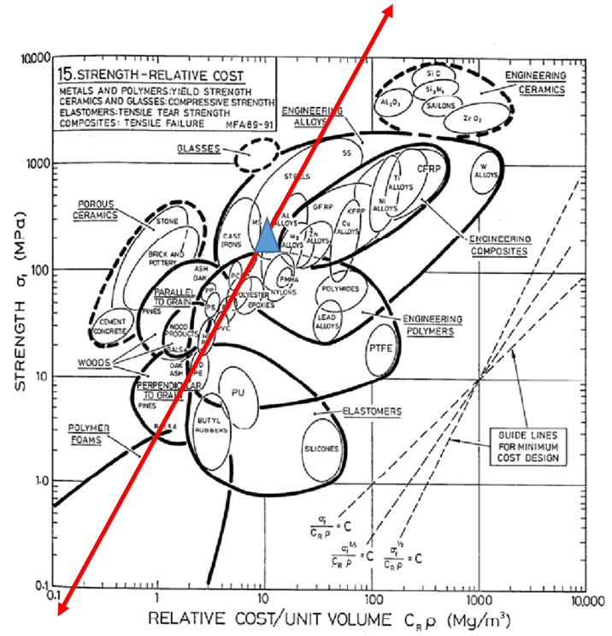
Material Analysis:
Outer Metal Cover
Function:
Aesthetic design and protection of outer housing
Current Material:
Aluminum/Steel Alloy
Objective:
Potentially remove the part and exploring comparable materials that reduce the need for metal manufacturing
Conclusion:
Engineering polymers, elastomers, and polymer foams meet the strength vs. cost objective
Remove outer cover and create an extra layer of ABS
Notes:
Monique

Slide 14
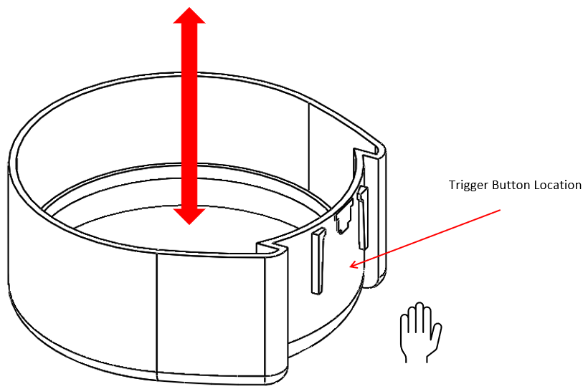
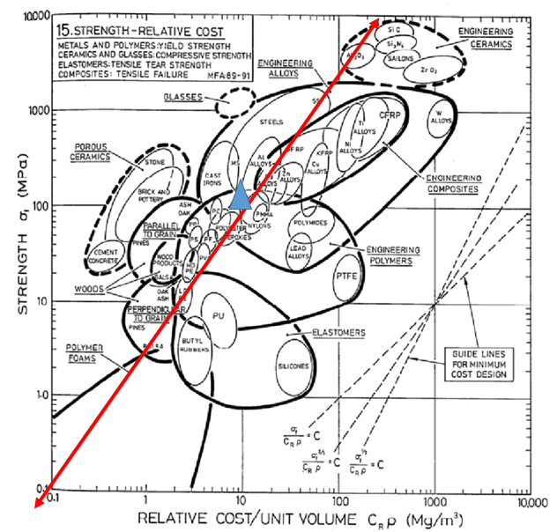
Material Analysis:
Trigger
Function:
Activate spring that allows user to open grinder cap
Current Material:
ABS
Objective:
Decrease cost by reducing the need of the part, potentially combine with coffee grinder cap
Conclusion:
Porous ceramics, polymer foam, and engineering polymers were the alternative materials
Confirmed that the engineering polymer is the best material category
Combined trigger and grinder cap for PVC assembly
Notes:
Monique

Slide 15
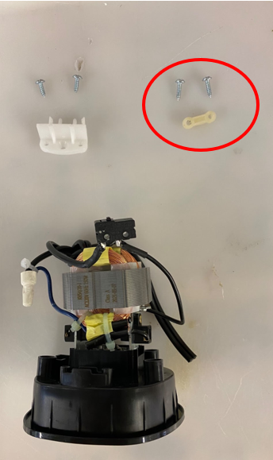
Material Analysis:
Cable Holder
Function:
Hold cables connected to the plastic base, holes allow for screws to secure
Current Material:
ABS
Objective:
Decrease cost by reducing the need of the part, potentially combine with coffee grinder cap
Conclusion:
Eliminate parts create a unnecessary secondary step for manufacturers
Use a thicker, reinforced wire on the wire-harness instead
Notes:
Monique

Slide 16
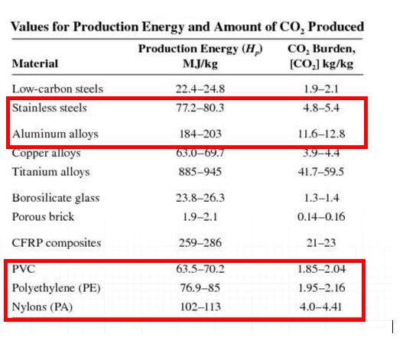
Long Term Impact of Material Analysis
Removing unnecessary metal parts
Combining plastic assemblies
Removing parts that require hardware/secondary operations for assembler

Slide 17
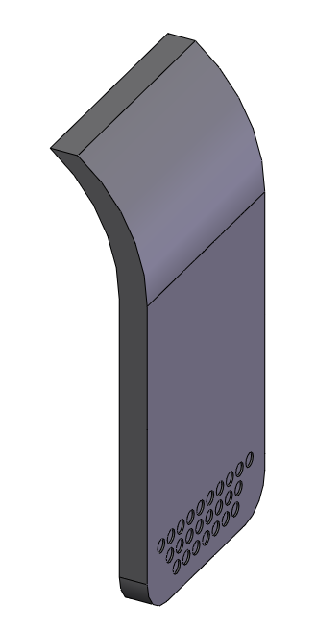
Process Analysis: Trigger
Original manufacturing process for ABS is likely injection molding
Followed process 1st approach
Complexity of the shape
Processes capable of producing that shape
Rejection of processes based on PVC chosen material
Screening based on cycle time, tooling costs, quality, etc.
Economic analysis comparing original to redesign

Slide 18
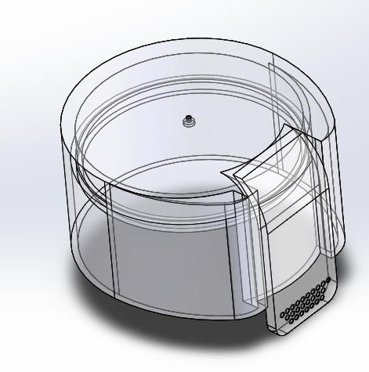
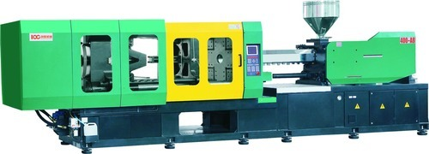
Process Analysis Conclusions
PVC material is best known for its resistance to environmental degradation due to its high density and strength
PVC comes in two forms: rigid and flexible
PVC is very similar to other forms of injection molding except it requires a double-mold made of a strong metal
Cycle time and tooling cots put PVC below current ABS process
Cost analysis of redesigning the cap to be one part proved to save roughly $0.60/unit

Slide 19
Economic Analysis of Product
Shared capital cost across parts with same processes (Plastic Injection Mold & Sheet Bending)
Notes:
Alex

Slide 20
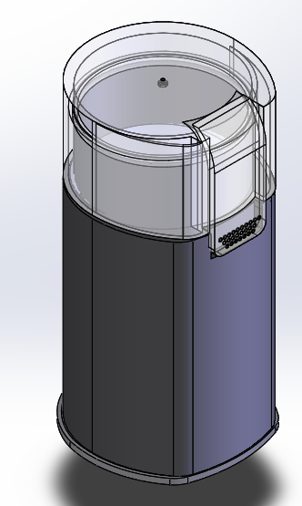
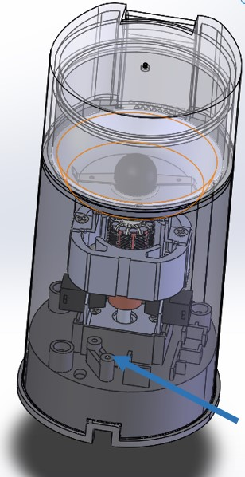
Redesign
Combining cap and the trigger into one part
Remove outer metal housing/combine to reduce parts
Remove cable holder
Notes:
Mike

Slide 21
Conclusions & Final Thoughts
Combine Parts
Material Selection
Manufacturing Selection
Decrease part number and increase efficiencies on DFA
Verify the best material selection based on function and cost
Optimize the existing manufacturing processes for redesign
Notes:
Monique

Slide 22
THANK YOU!
Questions?
Notes:
Monique

